Slide 1
Hands-On with Generative AI
Mayur Madnani
Dec 2024

Slide 2
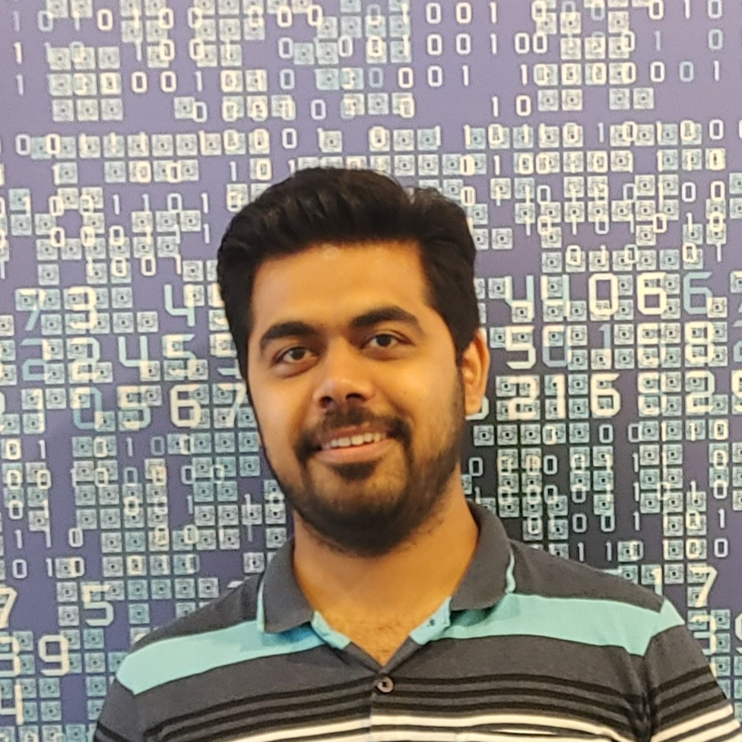
Who am I?
Worked with technology giants such as SAP, Walmart, Intuit, and Viacom18
Technology expert in Software, Data and AI
Published research and patent
Industry mentor
Instructor for Azure Generative Vision AI course: bit.ly/genai-vision
LinkedIn: linkedin.com/in/mayurmadnani/

Slide 3
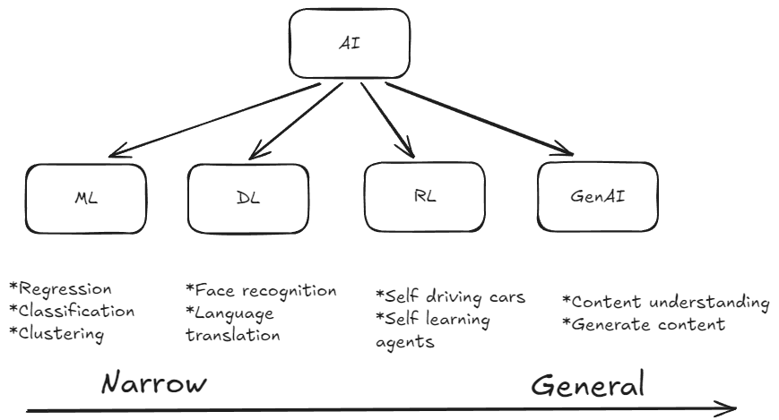

Slide 4
Demo Time
https://github.com/mayurmadnani/CodeCraftStories/tree/main/2024-12-hands-on-generative-ai

Slide 5
Thank you

Slide 6

Any Questions?
Post Session Question Form
Classroom content
Coupon Code: BLACKFRIDAY

